Slide 1
Matrix Multiplication Using Divide and Conquer

Slide 2

Basic Matrix Multiplication
Suppose we want to multiply two matrices of size N x N: for example A x B = C.
C₁₁ = a₁₁b₁₁ + a₁₂b₂₁
C₁₂ = a₁₁b₁₂ + a₁₂b₂₂
C₂₁ = a₂₁b₁₁ + a₂₂b₂₁
C₂₂ = a₂₁b₁₂ + a₂₂b₂₂
2x2 matrix multiplication can be accomplished in 8 multiplication.(2^{log}₂⁸ =2³)

Slide 3
Basic Matrix Multiplication
void matrix_mult (){
for (i = 1; i <= N; i++) {
for (j = 1; j <= N; j++) { compute C_{i,j}; }
}}
algorithm
Time analysis

Slide 4
Strassens’s Matrix Multiplication
Strassen showed that 2x2 matrix multiplication can be accomplished in 7 multiplication and 18 additions or subtractions. .(2^{log}₂⁷ =2^{2.807})
This reduce can be done by Divide and Conquer Approach.

Slide 5

Using Divide and Conquer
Step 1: Divide matrices into sub matrices of size n/2
Step 2: Multiply each part using recursion
Step 3: Solve the terminating condition (2 x 2) using basic/Strassen’s Matrix multiplication
Assume n is power of 2

Slide 6
Divide and Conquer Matrix Multiply
A × B = R
A₀ | A₁
A₂ | A₃
B₀ | B₁
B₂ | B₃
A₀×B₀+A₁×B₂ | A₀×B₁+A₁×B₃
A₂×B₀+A₃×B₂ | A₂×B₁+A₃×B₃
×
=
Divide matrices into sub-matrices: A₀ , A₁, A₂ etc
Use blocked matrix multiply equations
Recursively multiply sub-matrices

Slide 7

Strassen’s Matrix Multiplication
Define seven sub matrix products
$S_{1}$= $A\left(F −H\right)$
$S_{2}$= $\left(A+B\right)H$
$S_{3}$= $\left(C+D\right)E$
$S_{4}$= $D\left(G −E\right)$
$S_{5}$= $(A+D)\left(E+H\right)$
${ S}_{6}$= $\left(B−D\right)\left(G+H\right)$
${ S}_{7}$= $\left(A−C\right)\left(E+F\right)$

Slide 8
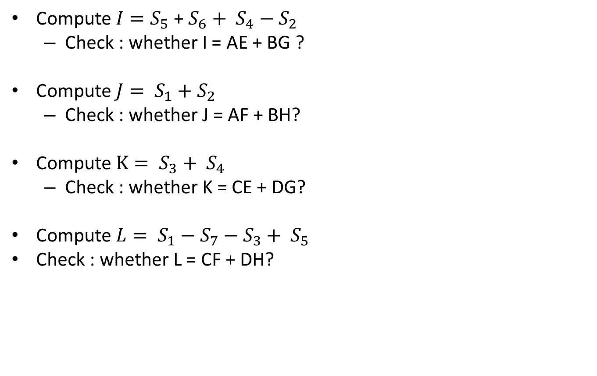
Compute $I=S_{5}$ + $S_{6}+ S_{4}−S_{2}$
  Check : whether I = AE + BG ?
Compute $J= S_{1}+S_{2}$
  Check : whether J = AF + BH?
Compute $K= S_{3}+ S_{4}$
  Check : whether K= CE + DG?
Compute $L= S_{1}−S_{7}−S_{3}+ S_{5}$
Check : whether L = CF + DH?

Slide 9
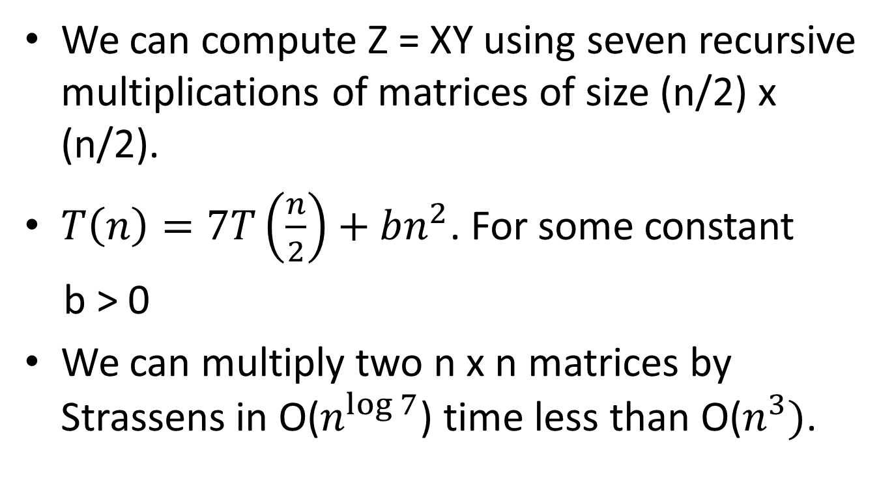
We can compute Z = XY using seven recursive multiplications of matrices of size (n/2) x (n/2).
$T\left(n\right)=7T\left(\frac{n}{2}\right)+bn^{2}$. For some constant
b > 0
We can multiply two n x n matrices by Strassens in O($n^{\log{7}}$) time less than O($n^{3})$.

Slide 10
Applying this algo when n is not in the power of 2,
Make the size to the nearest power of 2.
Make the value of all extra rows to be zero.
Make the value of all extra columns to be zero.
Then apply the algo.
Ex : if n = 3, make a 4 x 4 matrix.

